Slide 1
ONLINE SHOPPING WEBSITE
NAME OF OUR WEBSITE – SHOPMONK.COM
MADE BY –
ABHIJEET SINGH JANGPANGI (20BCS1719)
DEVANSH PUNJ (20BCS1722)

Slide 2
SUMMARY
We have made an online responsive shopping website which will have login/ Signup option from where a user can log in or sign up in our website using their password they have created. In the front page, we have made animations using GSAP which is the most robust high-performance Javascript animation library. We have various sections of shopping like Men’s informal, Men’s formal, Fashion accessories, and Girl’s collection. With the help of boxicons ( which is an open source free collection of carefully crafted icons) we have added cart icon, social media icons, and rating icons. Then we have about and contact us sections and a review section too which have some reviews about our website. With the help of contact us, any user can connect to us using various social media platforms.

Slide 3
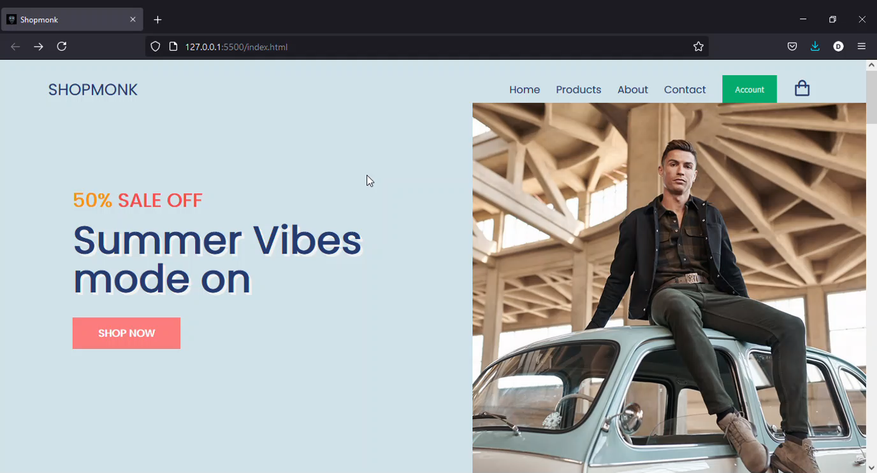
FRONT PAGE OF OUT WEBSITE

Slide 4
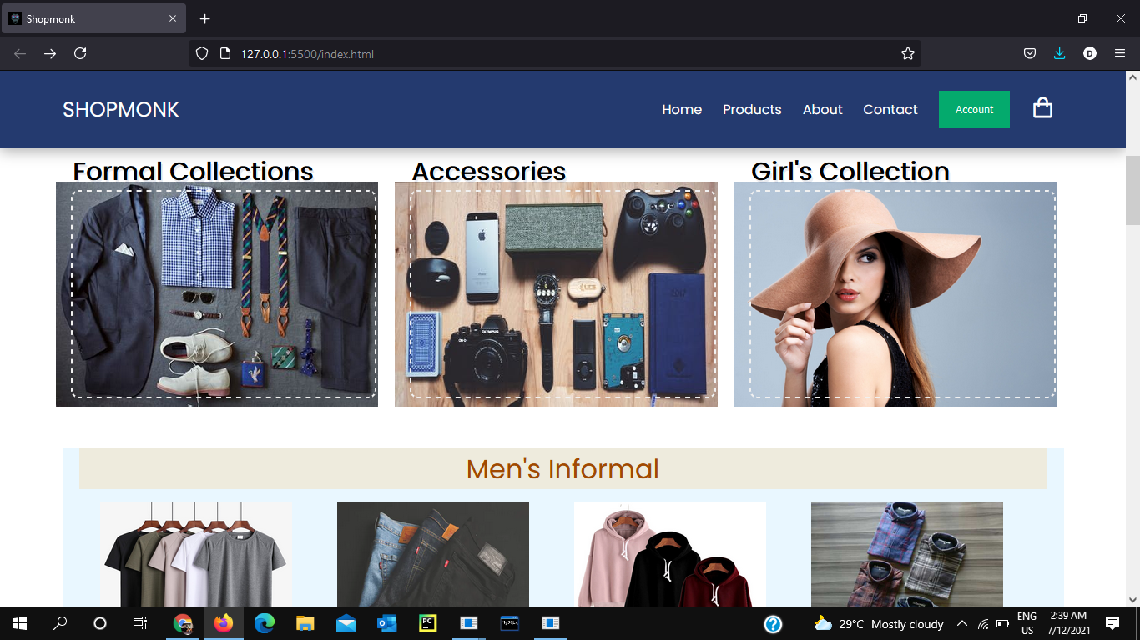
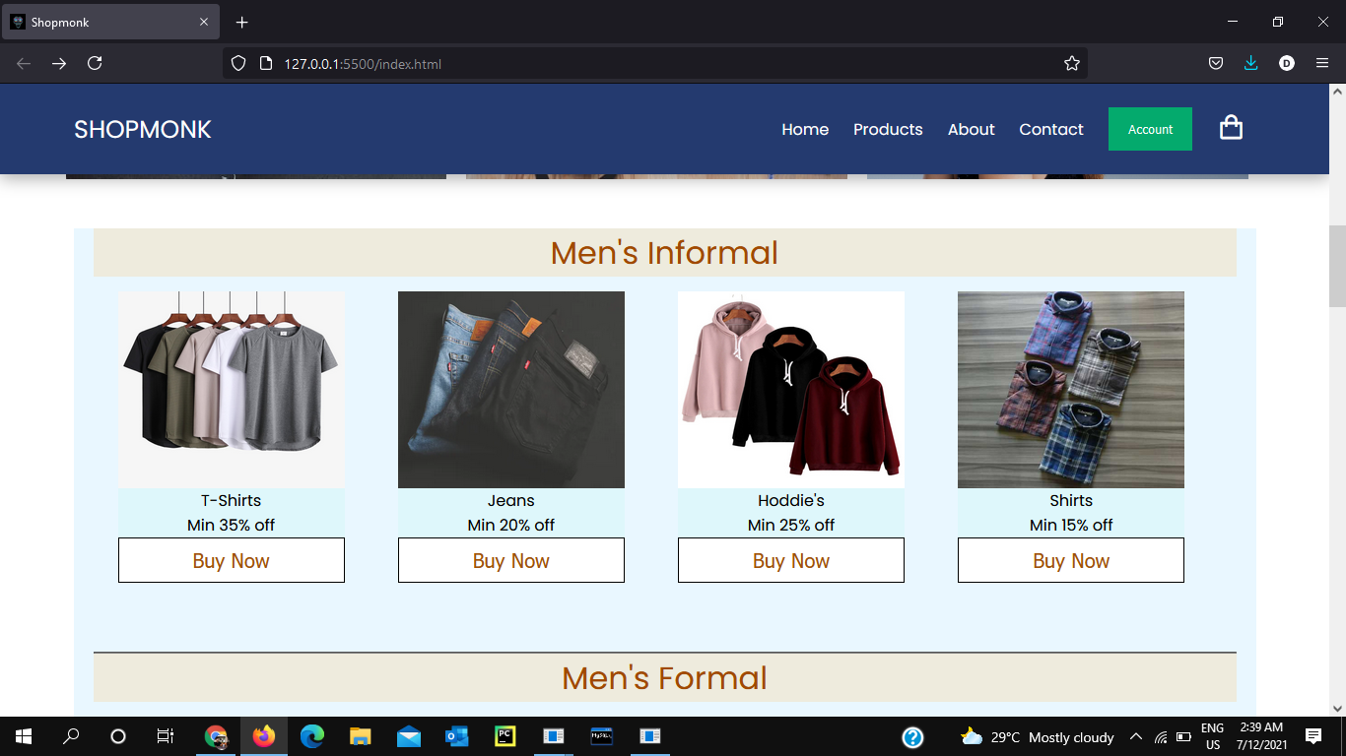
PICS OF PRODUCT SECTION

Slide 5
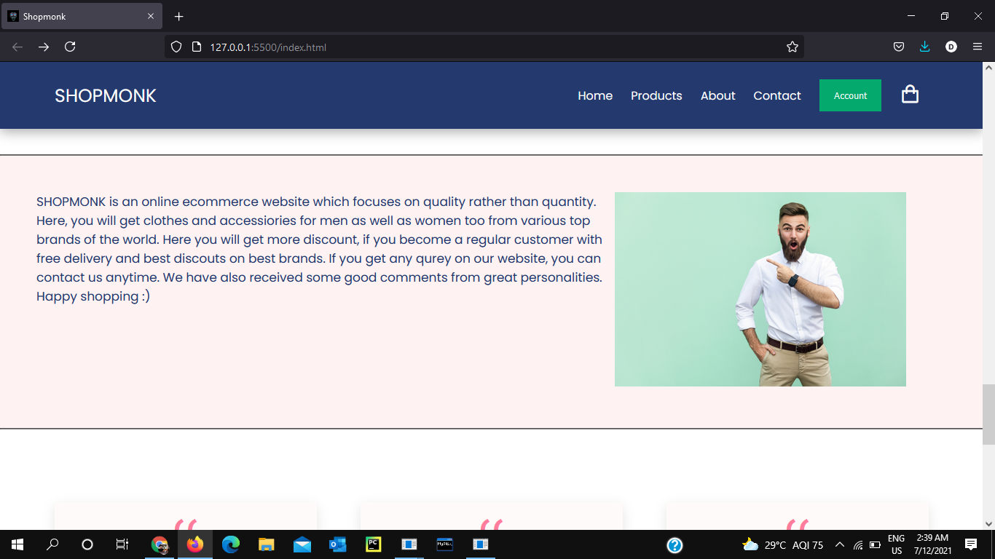
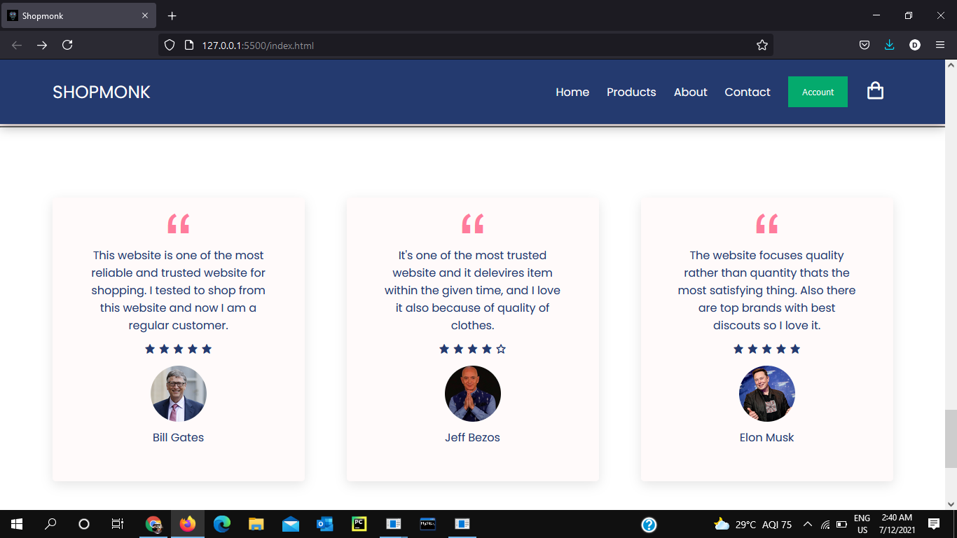
ABOUT AND REVIEW SECTION

